Slide 1

ISI
Information Systems Integration
Computer Systems Engineering
2022/2023
Luís Ferreira | Óscar Ribeiro

Slide 2

Overview:
Degree: Computer Systems Engineering
UC: Information Systems Integration
Scientific Area : Information Technologies
ECTS: 6

Slide 3
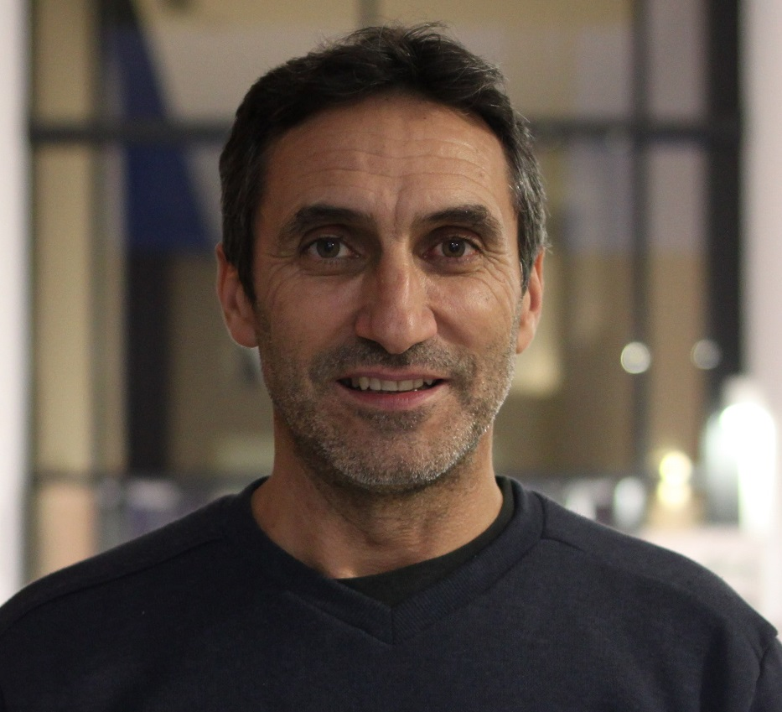
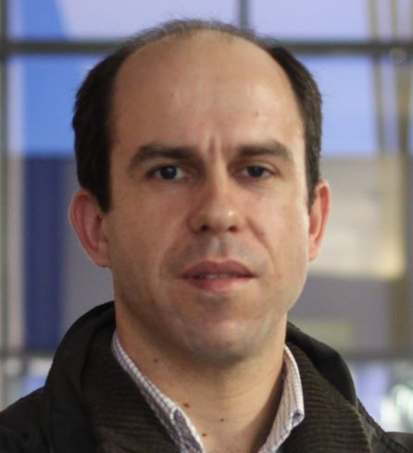
Teachers:
Name: Luís Ferreira
Office: 5
Contacts:
lufer@ipca.pt
skype: gonlufer
Zoom: https://videoconf-colibri.zoom.us/j/6572267809
Name: Óscar RIbeiro
Office: 5
Contacts:
oribeiro@ipca.pt
skype:
Zoom:

Slide 4
Teachers:
Daytime Calendar
Monday: 16:00-18:00, Lab IoT
Thursday: 14:00-16:00, Lab IoT
Overnight Calendar
Wednesday: 20:30-22:30, Lab IoT
Friday: 20:30-22:30, Lab IoT

Slide 5
Teachers:
Daytime Calendar
Monday: 16:00-18:00, Lab IoT
Thursday: 14:00-16:00, Lab IoT
Overnight Calendar
Wednesday: 20:30-22:30, Lab IoT
Friday: 20:30-22:30, Lab IoT
Attending schedule Thursday: 16:00-18:00 (attendance room)
Tuesday: 21:00-22:00 (online email/zoom)
Attending schedule Tuesday: 18:00-19:00 (attendance room)
Friday: 17:00-18:00 (online email/zoom)

Slide 6
Classes: (20-09-2021 → 15-01-2022)
Daytime
Monday | 16.00h – 18.00h
Tuesday | 09.00h – 11.00h
Attendance
Daytime
Tuesday * | 16.00h – 18.00h
Tuesday ** | 22.00h – 23.00h
* Office ** Skype (gonlufer) | Zoom (https://videoconf-colibri.zoom.us/j/6572267809)

Slide 7
Classes: (20-09-2021 → 15-01-2022)
Daytime
Monday | 16.00h – 18.00h
Tuesday | 09.00h – 11.00h
Overnight
Monday | 16.00h – 18.00h
Tuesday | 09.00h – 11.00h
Attendance
Daytime |  |  | Post-labour
Friday * | 11.00h – 13.00h |  | Thursday * | 18.00h – 20.00h
Tuesday ** | 21.00h – 22.00h |  | Tuesday ** | 22.00h – 23.00h
* Office nº 5 ** Skype (gonlufer) | Zoom (https://videoconf-colibri.zoom.us/j/6572267809)

Slide 8
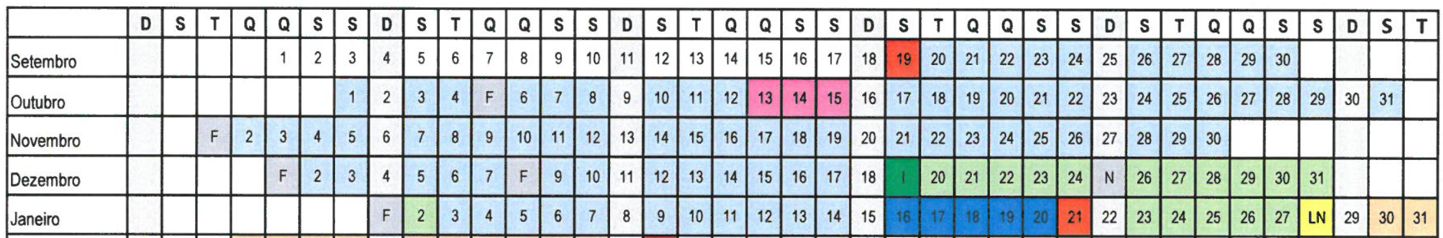
Classes: (19-09-2022 → 21-01-2023)
Daytime
Monday | 16.00h – 18.00h
Thursday | 14.00h – 16.00h
Overnight
Wednesday | 20.30h – 22.30h
Friday | 20.30h – 22.30h

Slide 9
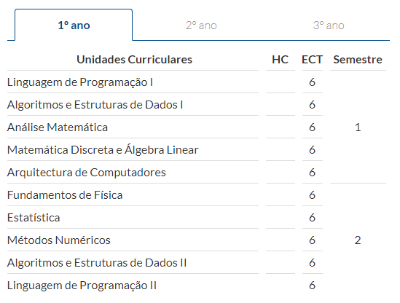
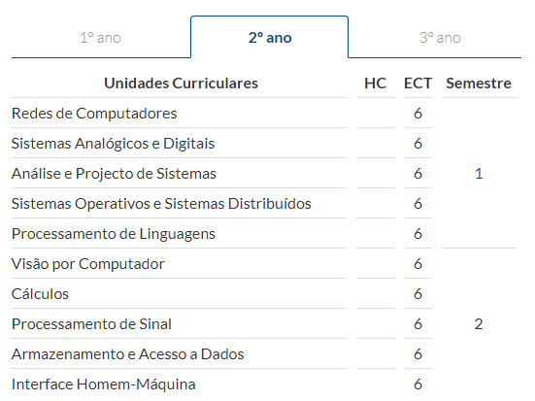
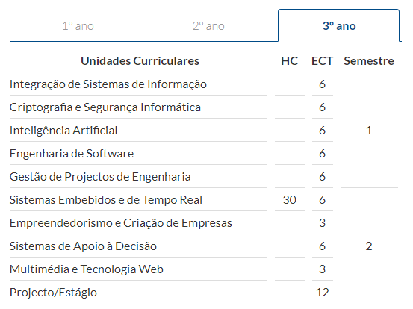
Curriculum:

Slide 10
Syllabus
Cloud Computing
Systems Architectures
Services Oriented Architectures (SOA)
SOAP Services
REST Services
Data Integration
ETL
Integration Services
Frameworks (PDI, MSSIS, Knime, …)
Industry Data Integration
Industry Systems Integration
Internet of Things
MicroServices
Overview
Enterprise Application Integration – EAI, IAI, EIP
Patterns e Middleware
Fundamentals
Integration Levels
Data Integration: XML, JSON, YAML, etc.
Data Serialization (Querying with LINQ)
Regular Expressions

Slide 11
Bibliography
Essential
Xu, L. D. (2015). Enterprise Integration and Information Architecture - A Systems Perspective on Industrial Information Integration. CRS Press.
George Reese (2009), Cloud Application Architectures, , O’Reilly
Luís Ferreira (2017), Textbook of UC Information Systems Integration – Part I
Web
Web services
http://www.tutorialspoint.com/webservices/
Semantic Web
http://www.linkeddatatools.com/semantic-web-basics
Free Books:
https://www.c-sharpcorner.com/ebooks/

Slide 12
Bibliography
Other
Professional XML 2nd Edition, Mark Birbeck et al. (2001);
RESTFull Web APIs, Leonard Richardson et al. (2013);
Service-Oriented Architecture, Thomas Erl (2017);
Microservices for the Enterprise, Kasun et al. (2018);
SQL Server 2017 Integration Services Cookbook, Christian Cote et al. (2017);
Pentaho Kettle Solutions: Build Open Source ETL Solutions with Pentaho Data Integration Matt Casters (2010);
Data Integration Best Practices, Jacob Horblulyk (2017);
Mastering XSLT (chapter 11) (ISBN: 0-7821-4094-7, Chuck White (2002);

Slide 13
Requirements
Programming and Algorithms!
Databases Management
Software Engineering
Project development

Slide 14
Assessment
Continuous Assessment:
NF = 40%*CP1 + 60%*CP2
CP1: First Practical Component = Practical work
CP2: Second Practical Component = Practical work
Minimum grade: 10 for CP1 and CP2
The assessment includes two practical assignments (CP1 and CP2) to be carried out individually
The practical work evaluation is individual and will be done on: i) written report; ii) the implementation of the solution and iii) the presentation and discussion.

Slide 15
Assessment
The practical component is not allowed to be carried out outside the continuous assessment period.
Only students who have obtained a classification in both practical components equal to or higher than 10 values will be admitted to the “appeal exam” (exams season, special season or exceptional season).

Slide 16
Assessment
The evaluation of each practical work is individual and will be based on:
Implementation of the solution (20%)
Written report (20%)
Individual presentation and discussion (60%)

Slide 17
Practical Work
Mandatory!
Individual or group of two people
Delivered via Git or Moodle
Report required
Individual presentation and defense

Slide 18
Moments for Assessment
1st Practical Work
Statement: October 5th
Delivery : October 25th
2nd Practical Work
Statement: November 1th
Delivery : Phase 1: December 14th | Phase 2: January 6th

Slide 19
Classes
Períod: September 19th - January 21th
Number: 29
Classes for Assessement
Presentation and Defense: 4 classes
Effective Classes: 24

Slide 20
Classes
Cloud Computing (10 classes)
Systems Architectures
Services Oriented Architectures (SOA)
SOAP Services
REST Services
Data Integration (5 classes)
ETL
Integration Services
Frameworks (PDI, MSSIS, Knime, …)
Industry Data Integration (2 classes)
Industry Systems Integration
Internet of Things
MicroServices
Overview (2 classes)
Enterprise Application Integration – EAI, IAI, EIP
Patterns e Middleware
Fundamentals (6 classes)
Integration Levels
Data Integration: XML, JSON, YAML, etc.
Data Serialization (Querying with LINQ)
Regular Expressions

